Slide 1
Longitudinal Analysis with Multilevel Modeling
EDUC 8825 Advanced Data Analysis
W. Joel Schneider

Slide 2
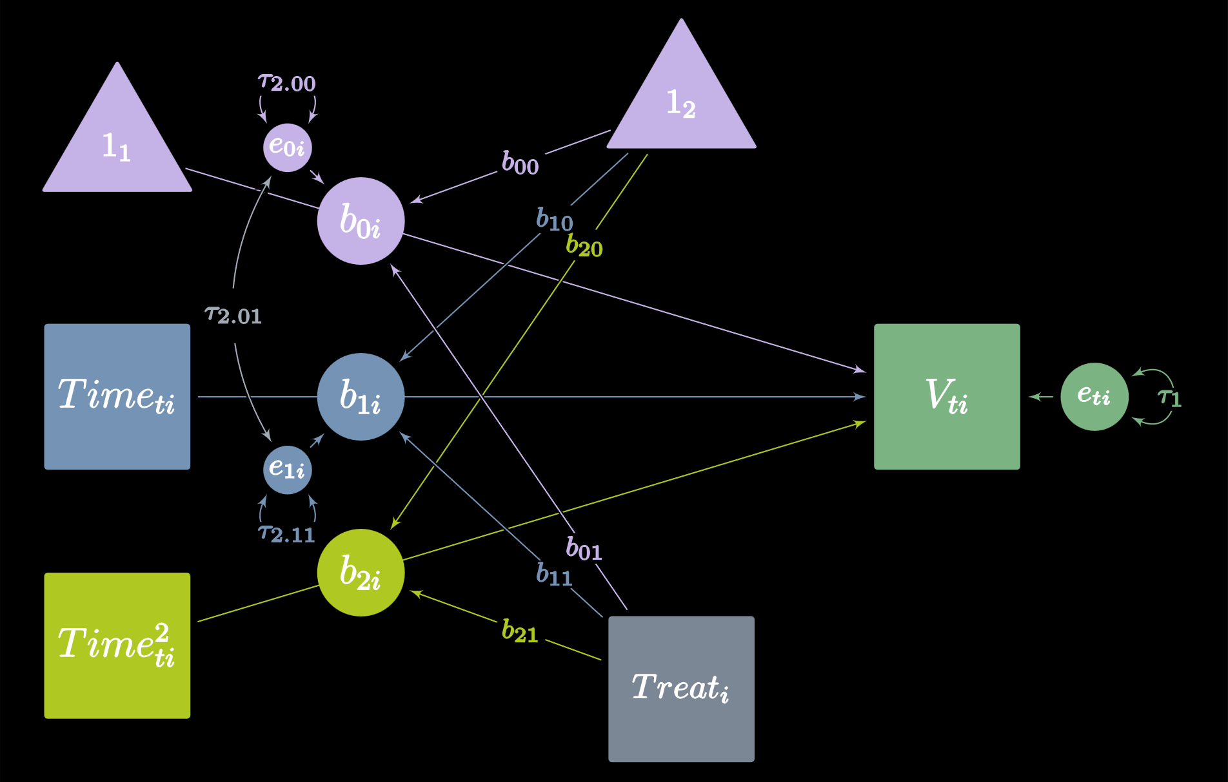
Path Diagrams for Longitudinal Multilevel Models
Vocabulary Growth as a Function of Treatment, Time, & Time²
2
Curran, P. J., & Bauer, D. J. (2007). Building path diagrams for multilevel models. Psychological Methods, 12(3), 283–297. https://doi.org/10.1037/1082-989X.12.3.283

Slide 3

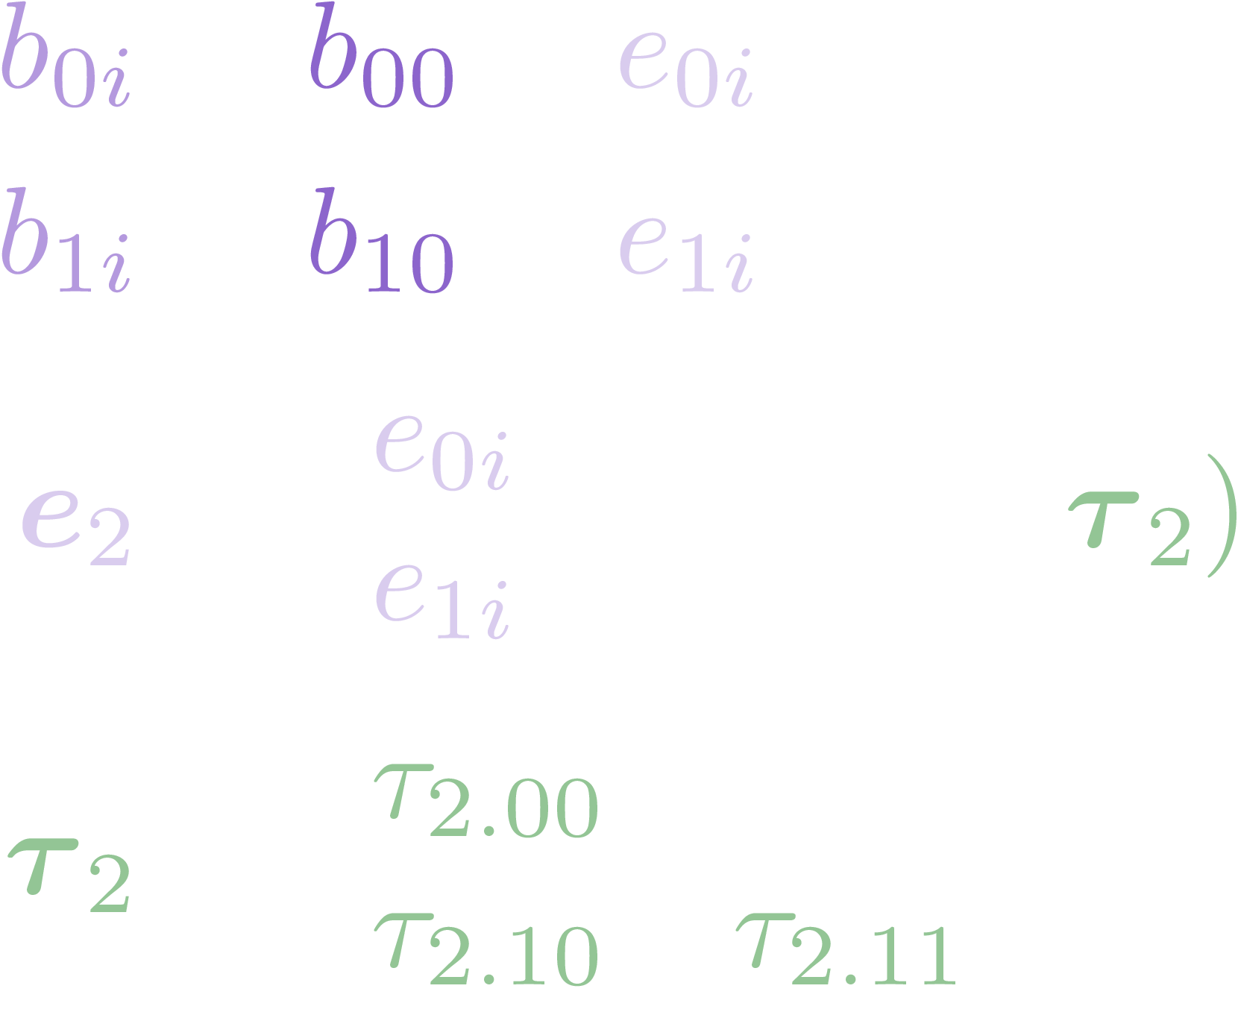
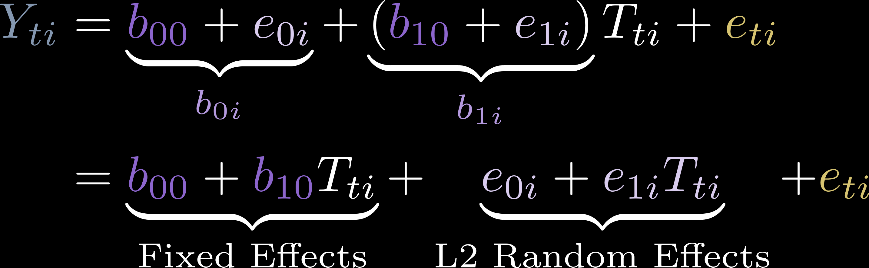
2-Level Longitudinal Model with Time as Covariate
Level 1
Level 2
Y ~ 1 + T + (1 + T | id)
R Model:

Slide 4
Model Sequence
Model | Formula
Random Intercepts | Y ~ 1 + (1 | id)
Linear Effect of Time | Y ~ 1 + T + (1 | id)
Quadratic Effect of Time? | Y ~ 1 + T + I(T^2) + (1 | id) Y ~ 1 + poly(T, 2, raw = TRUE) + (1 | id)
Cubic Effect of Time? More? | Y ~ 1 + T + I(T^2) + I(T^3) + (1 | id) Y ~ 1 + poly(T, 3, raw = TRUE) + (1 | id)
Random Slopes for Time | Y ~ 1 + T + (1 + T | id)
L1 Covariates | Y ~ 1 + T + L1 + (1 + T | id)
Interactions with Time | Y ~ 1 + T * L1 + (1 + T | id)
L2 Covariates | Y ~ 1 + T * L1 + L2 + (1 + T | id)
Interactions | Y ~ 1 + T * L1 * L2 + (1 + T | id)

Slide 5
Wide Data Vs. Long Data
Wide Data Used in SEM
Long Data Used in Mixed Models
id | x_1 | x_2 | y_1 | y_2
1 | 5 | 6 | 2 | 1
2 | 6 | 9 | 9 | 10
3 | 2 | 4 | 4 | 6
4 | 3 | 4 | 8 | 7
id | time | x | Y
1 | 1 | 5 | 2
1 | 2 | 6 | 1
2 | 1 | 6 | 9
2 | 2 | 9 | 10
3 | 1 | 2 | 4
3 | 2 | 4 | 6
4 | 1 | 3 | 8
4 | 2 | 4 | 7
Benefits: Really Complex Models with Multiple Outcomes
Benefits: Varying number of rows per person.
Time can be spaced differently for each person.

Slide 6
Latent Growth Model Features
Random Intercepts?
Random Slopes?
Autoregression?
Cross-lags?

Slide 7
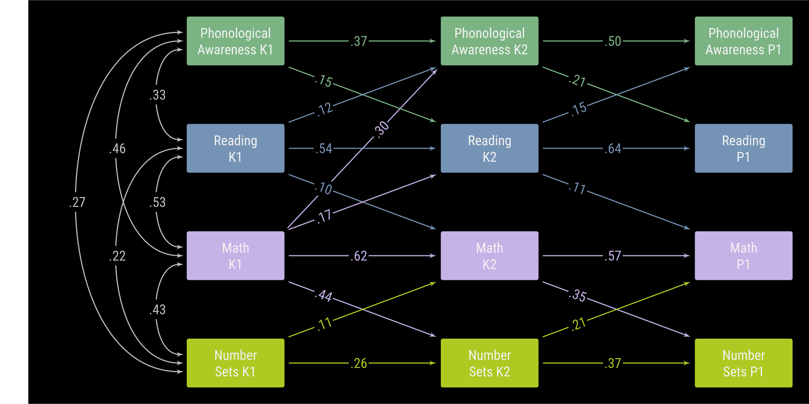
Cross-Lagged Autoregression
Kwok, F. Y., Bull, R., & Muñez, D. (2021). Cross-and Within-Domain Associations of Early Reading and Mathematical Skills: Changes Across the Preschool Years. Frontiers in Psychology, 4315.

Slide 8
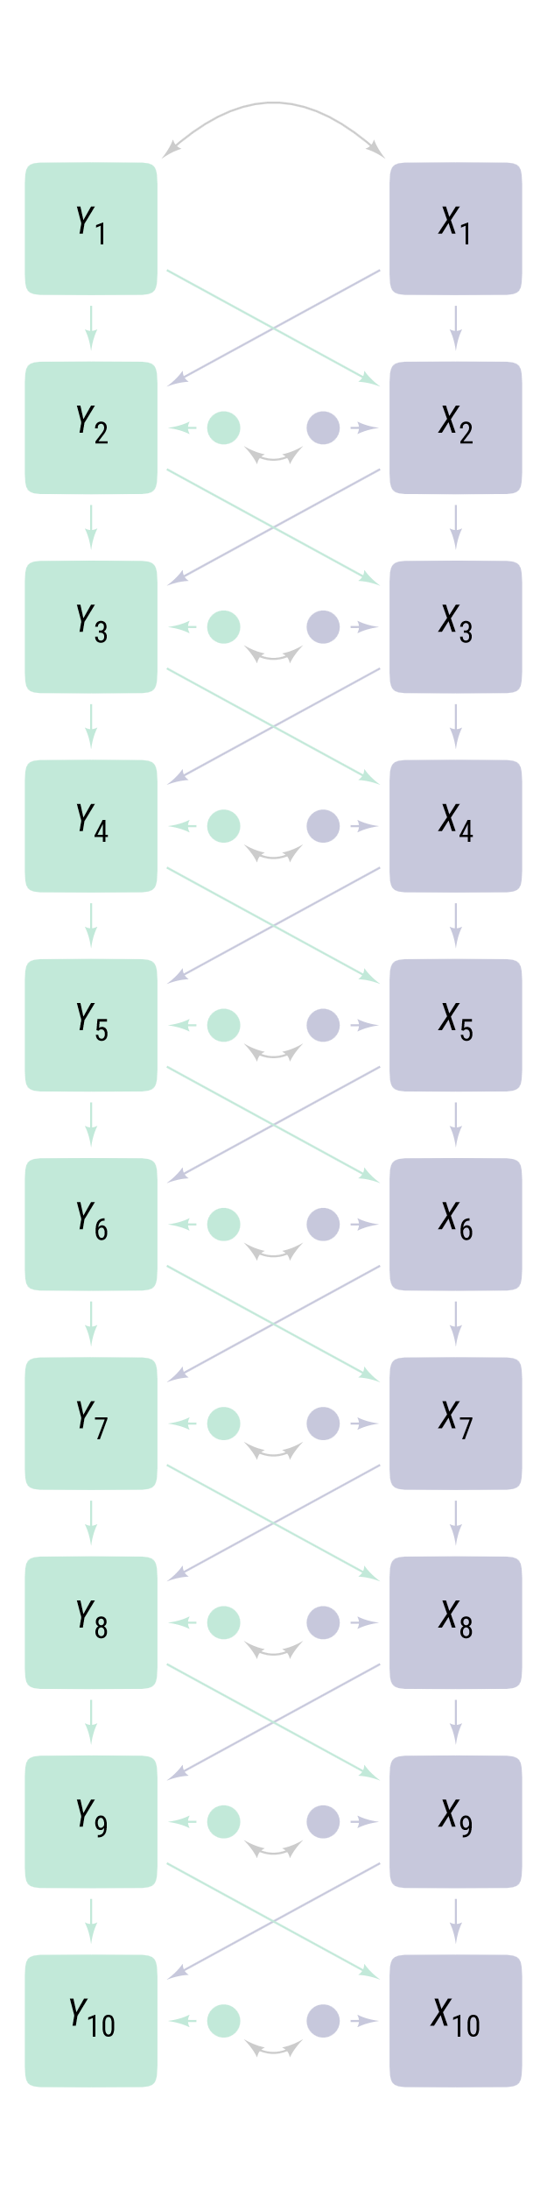
Cross-Lagged Problems
Failure to separate within-person stability from between-person stability will bias coefficients, which may lead to spurious findings.
Why?

Slide 9
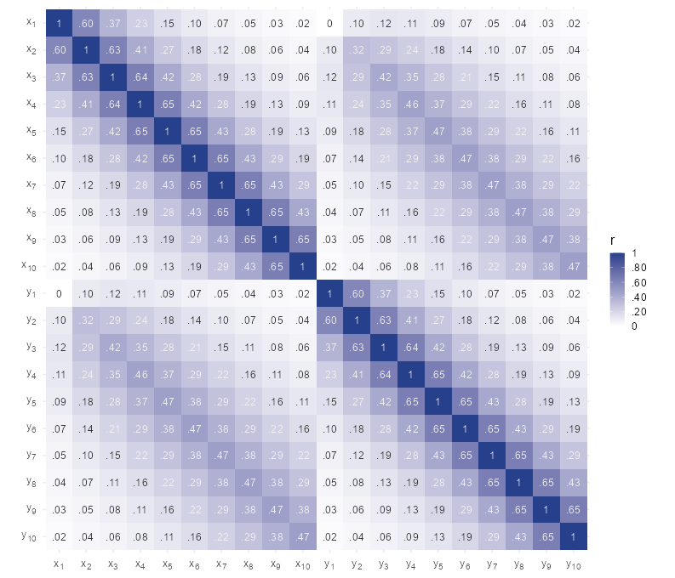
Long-term stability eventually goes to 0.

Slide 10
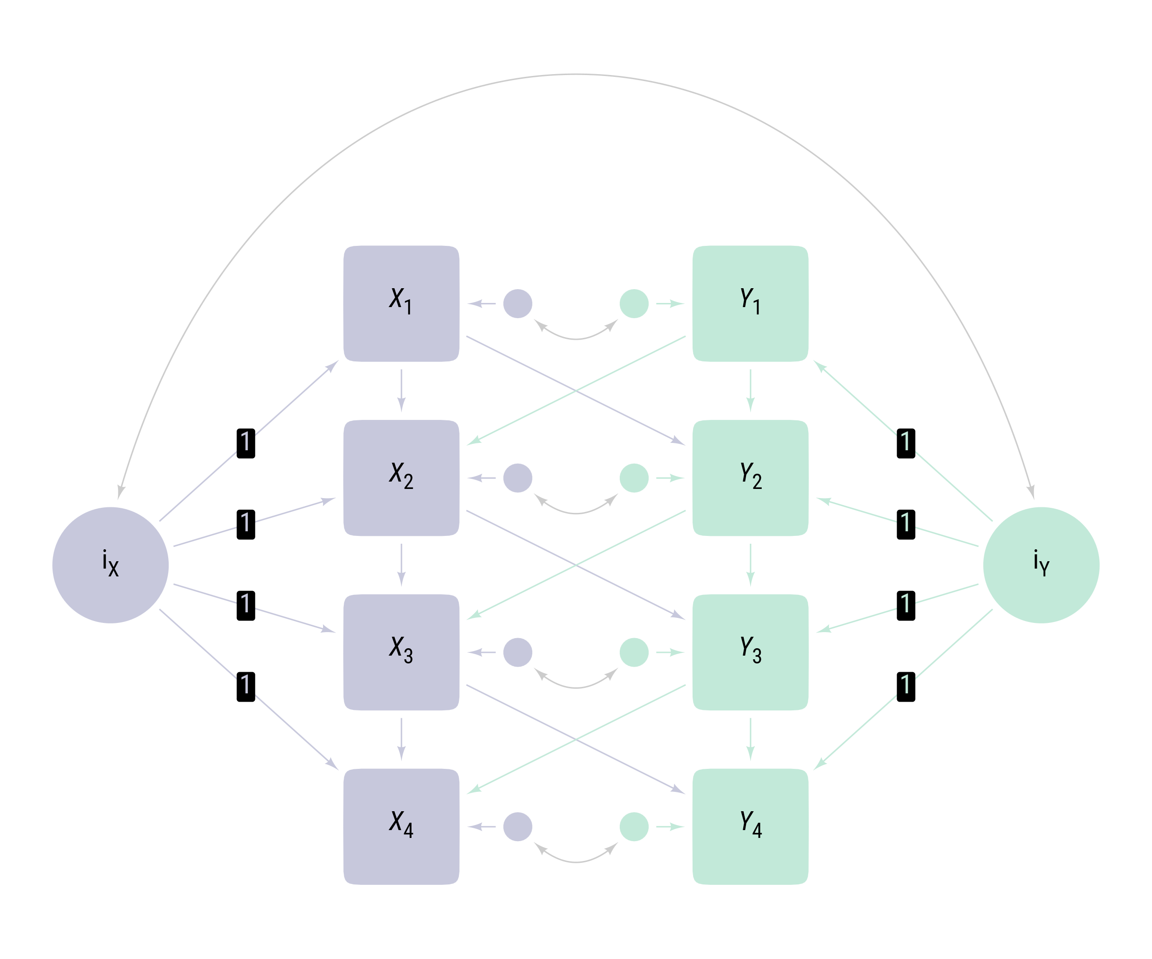
Cross-Lagged Autoregression
With Random Intercepts

Slide 11
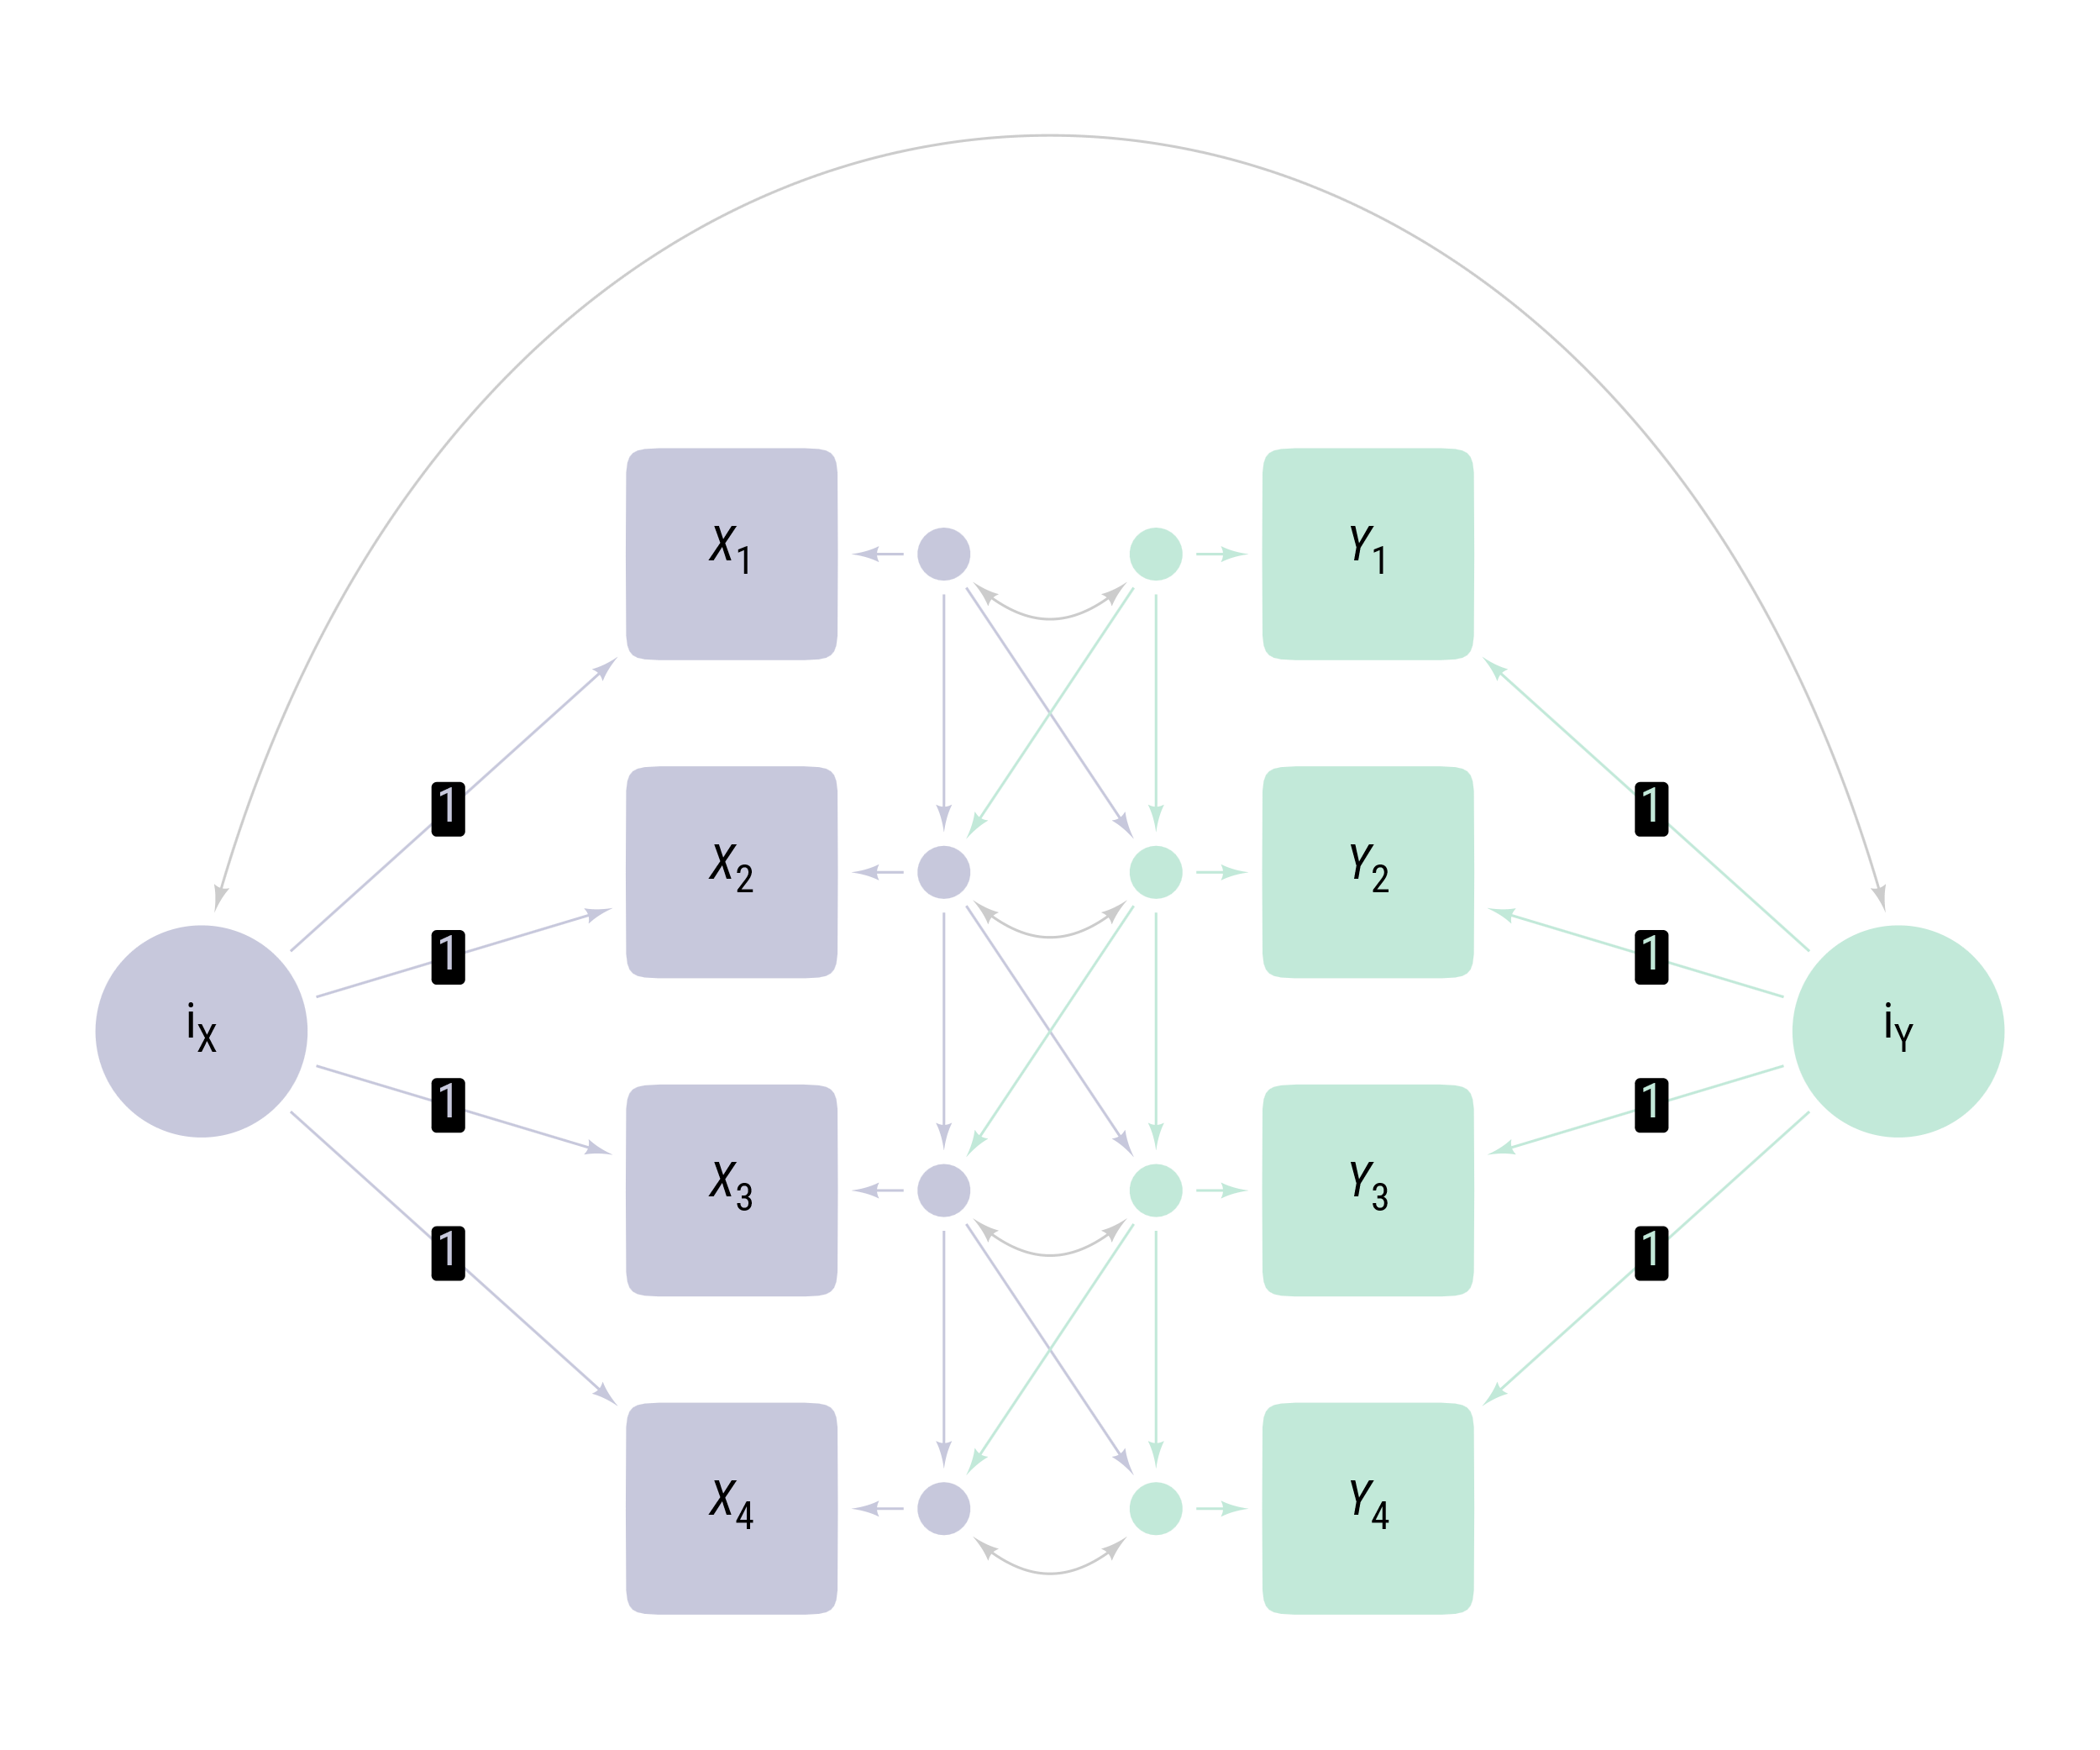
Cross-Lagged Autoregression
With Random Intercepts and Structured Residuals
Separating Between and Within-Person Change

Slide 12
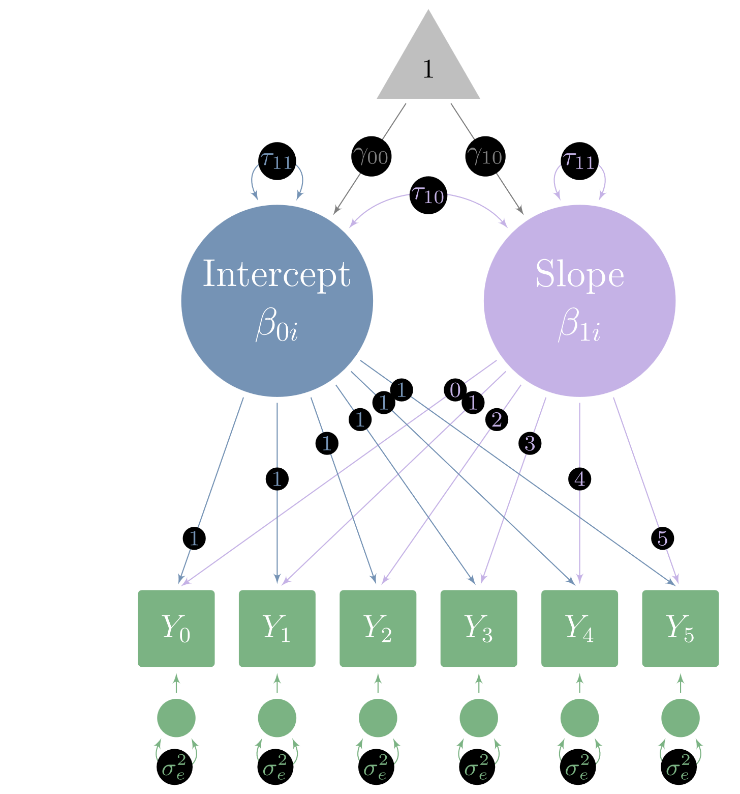
Latent Growth Modeling
Hierarchical Linear Model:
Y ~ 1 + T + (1 + T | id)
Latent Growth Model:
Y_i =~ 1 * Y_0 + 1 * Y_1 + 1 * Y_2 + 1 * Y_3 + 1 * Y_4 + 1 * Y_5
Y_s =~ 0 * Y_0 + 1 * Y_1 + 2 * Y_2 + 3 * Y_3 + 4 * Y_4 + 5 * Y_5
Y_i ~~ tau_00 * Y_i + tau_10 * Y_s
Y_s ~~ tau_11 * Y_s
Y_0 ~~ sigma_e2 * Y_0
Y_1 ~~ sigma_e2 * Y_1
Y_2 ~~ sigma_e2 * Y_2
Y_3 ~~ sigma_e2 * Y_3
Y_4 ~~ sigma_e2 * Y_4
Y_5 ~~ sigma_e2 * Y_5
Y_i ~ gamma_00 * 1
Y_s ~ gamma_10 * 1

Slide 13
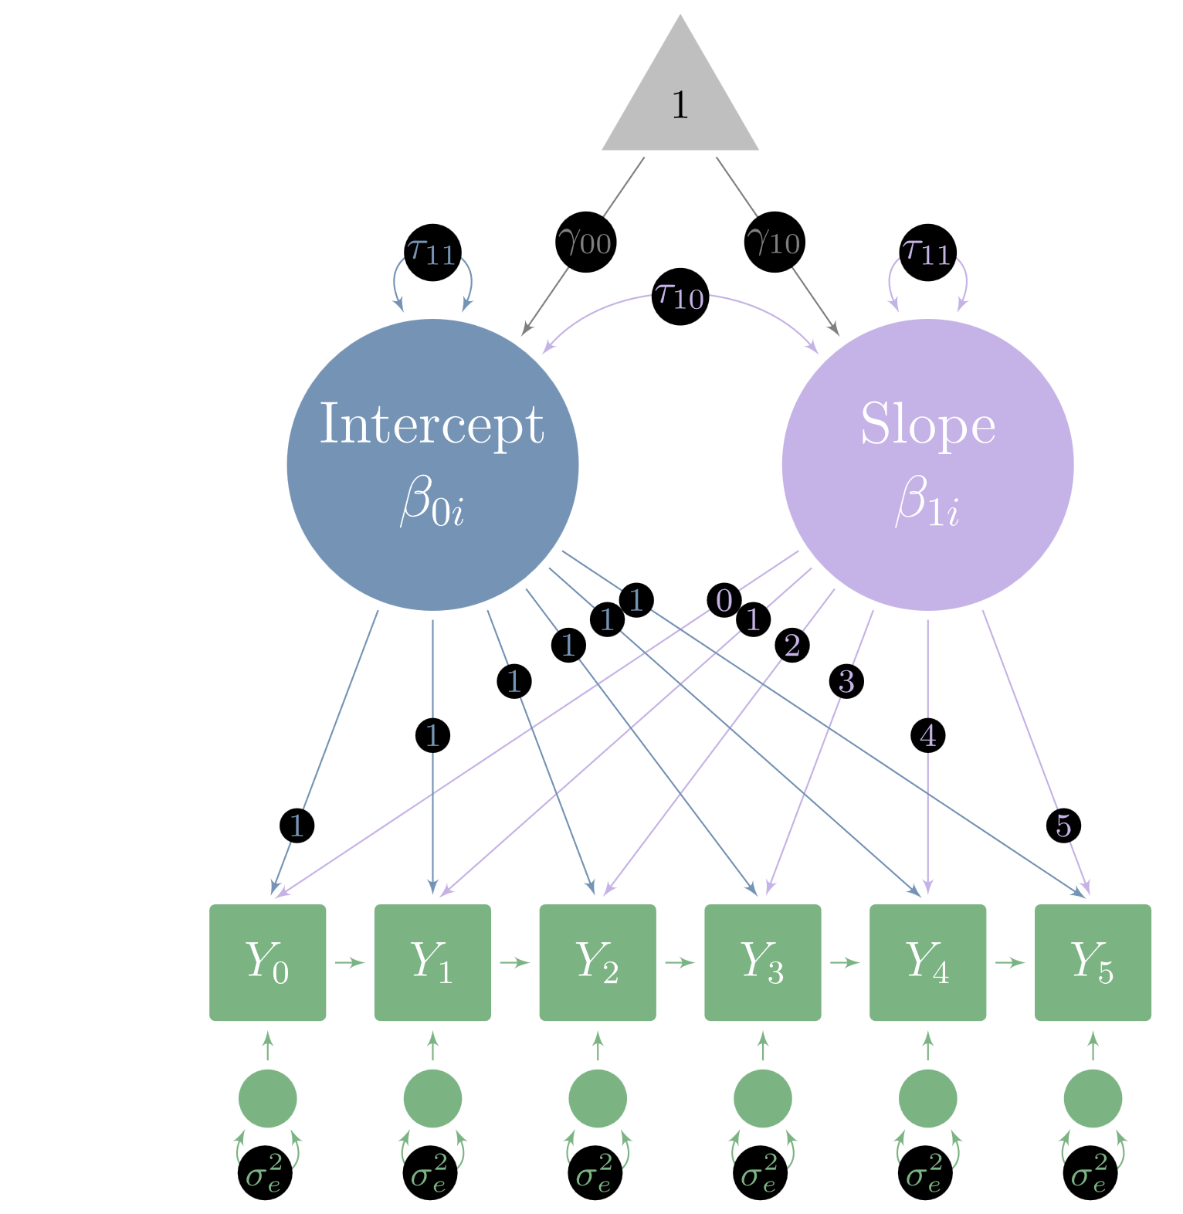
Latent Growth with Autoregression
Y_i =~ 1 * Y_0 + 1 * Y_1 + 1 * Y_2 + 1 * Y_3 + 1 * Y_4 + 1 * Y_5
Y_s =~ 0 * Y_0 + 1 * Y_1 + 2 * Y_2 + 3 * Y_3 + 4 * Y_4 + 5 * Y_5
Y_i ~~ tau_00 * Y_i + tau_10 * Y_s
Y_s ~~ tau_11 * Y_s
Y_0 ~~ sigma_e2 * Y_0
Y_1 ~~ sigma_e2 * Y_1
Y_2 ~~ sigma_e2 * Y_2
Y_3 ~~ sigma_e2 * Y_3
Y_4 ~~ sigma_e2 * Y_4
Y_5 ~~ sigma_e2 * Y_5
Y_i ~ gamma_00 * 1
Y_s ~ gamma_10 * 1
Y_5 ~ a * D4
Y_4 ~ a * D3
Y_3 ~ a * D2
Y_2 ~ a * D1
Y_1 ~ a * D0
a
a
a
a
a
Autoregression allows the residuals to influence the next measurement.

Slide 14
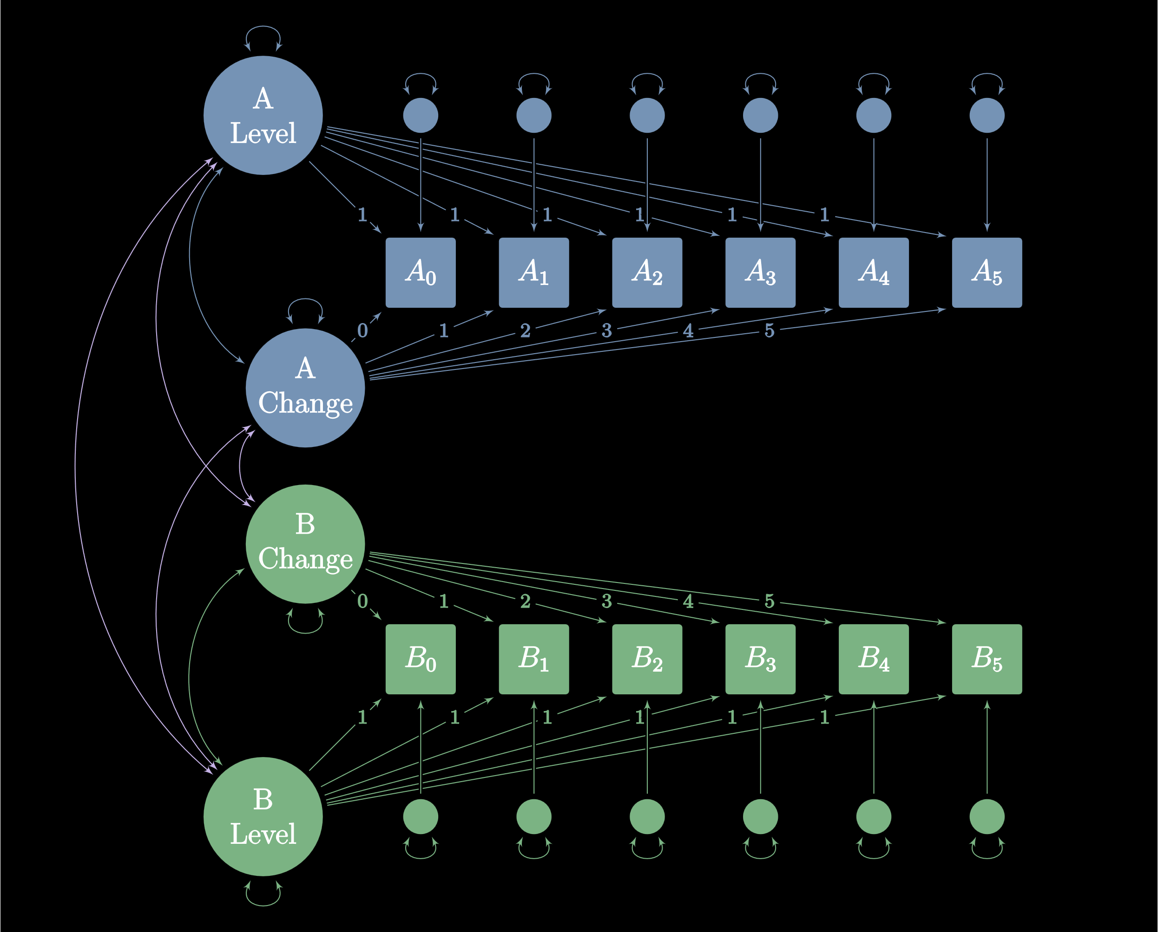
Bivariate Latent Change

Slide 15
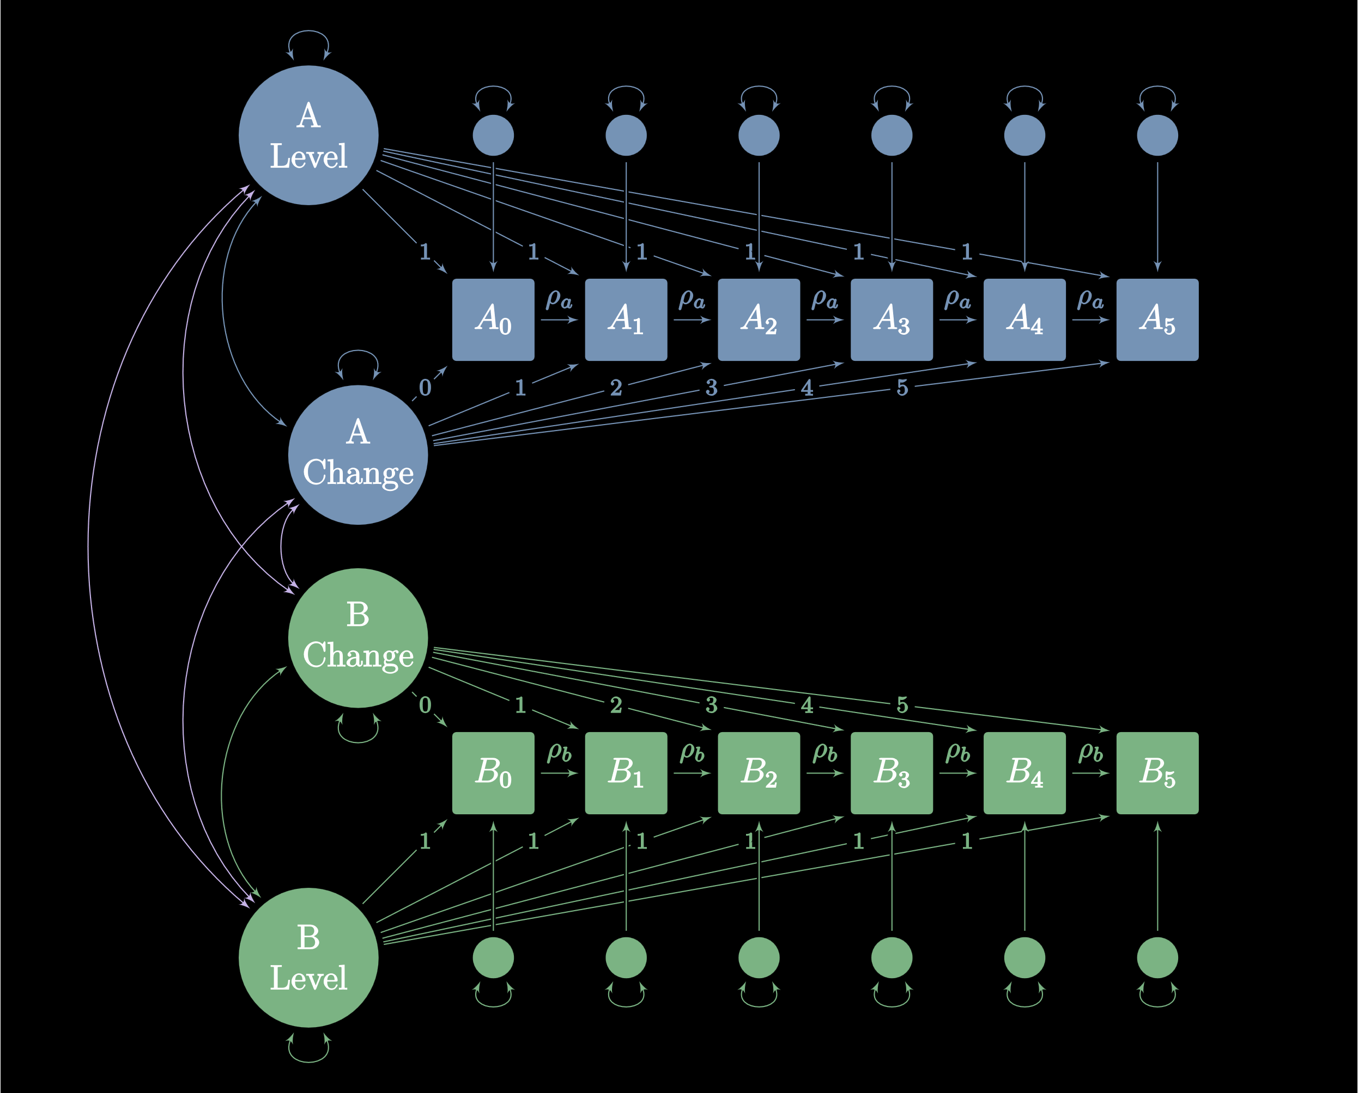
Autoregressive Bivariate Latent Change

Slide 16
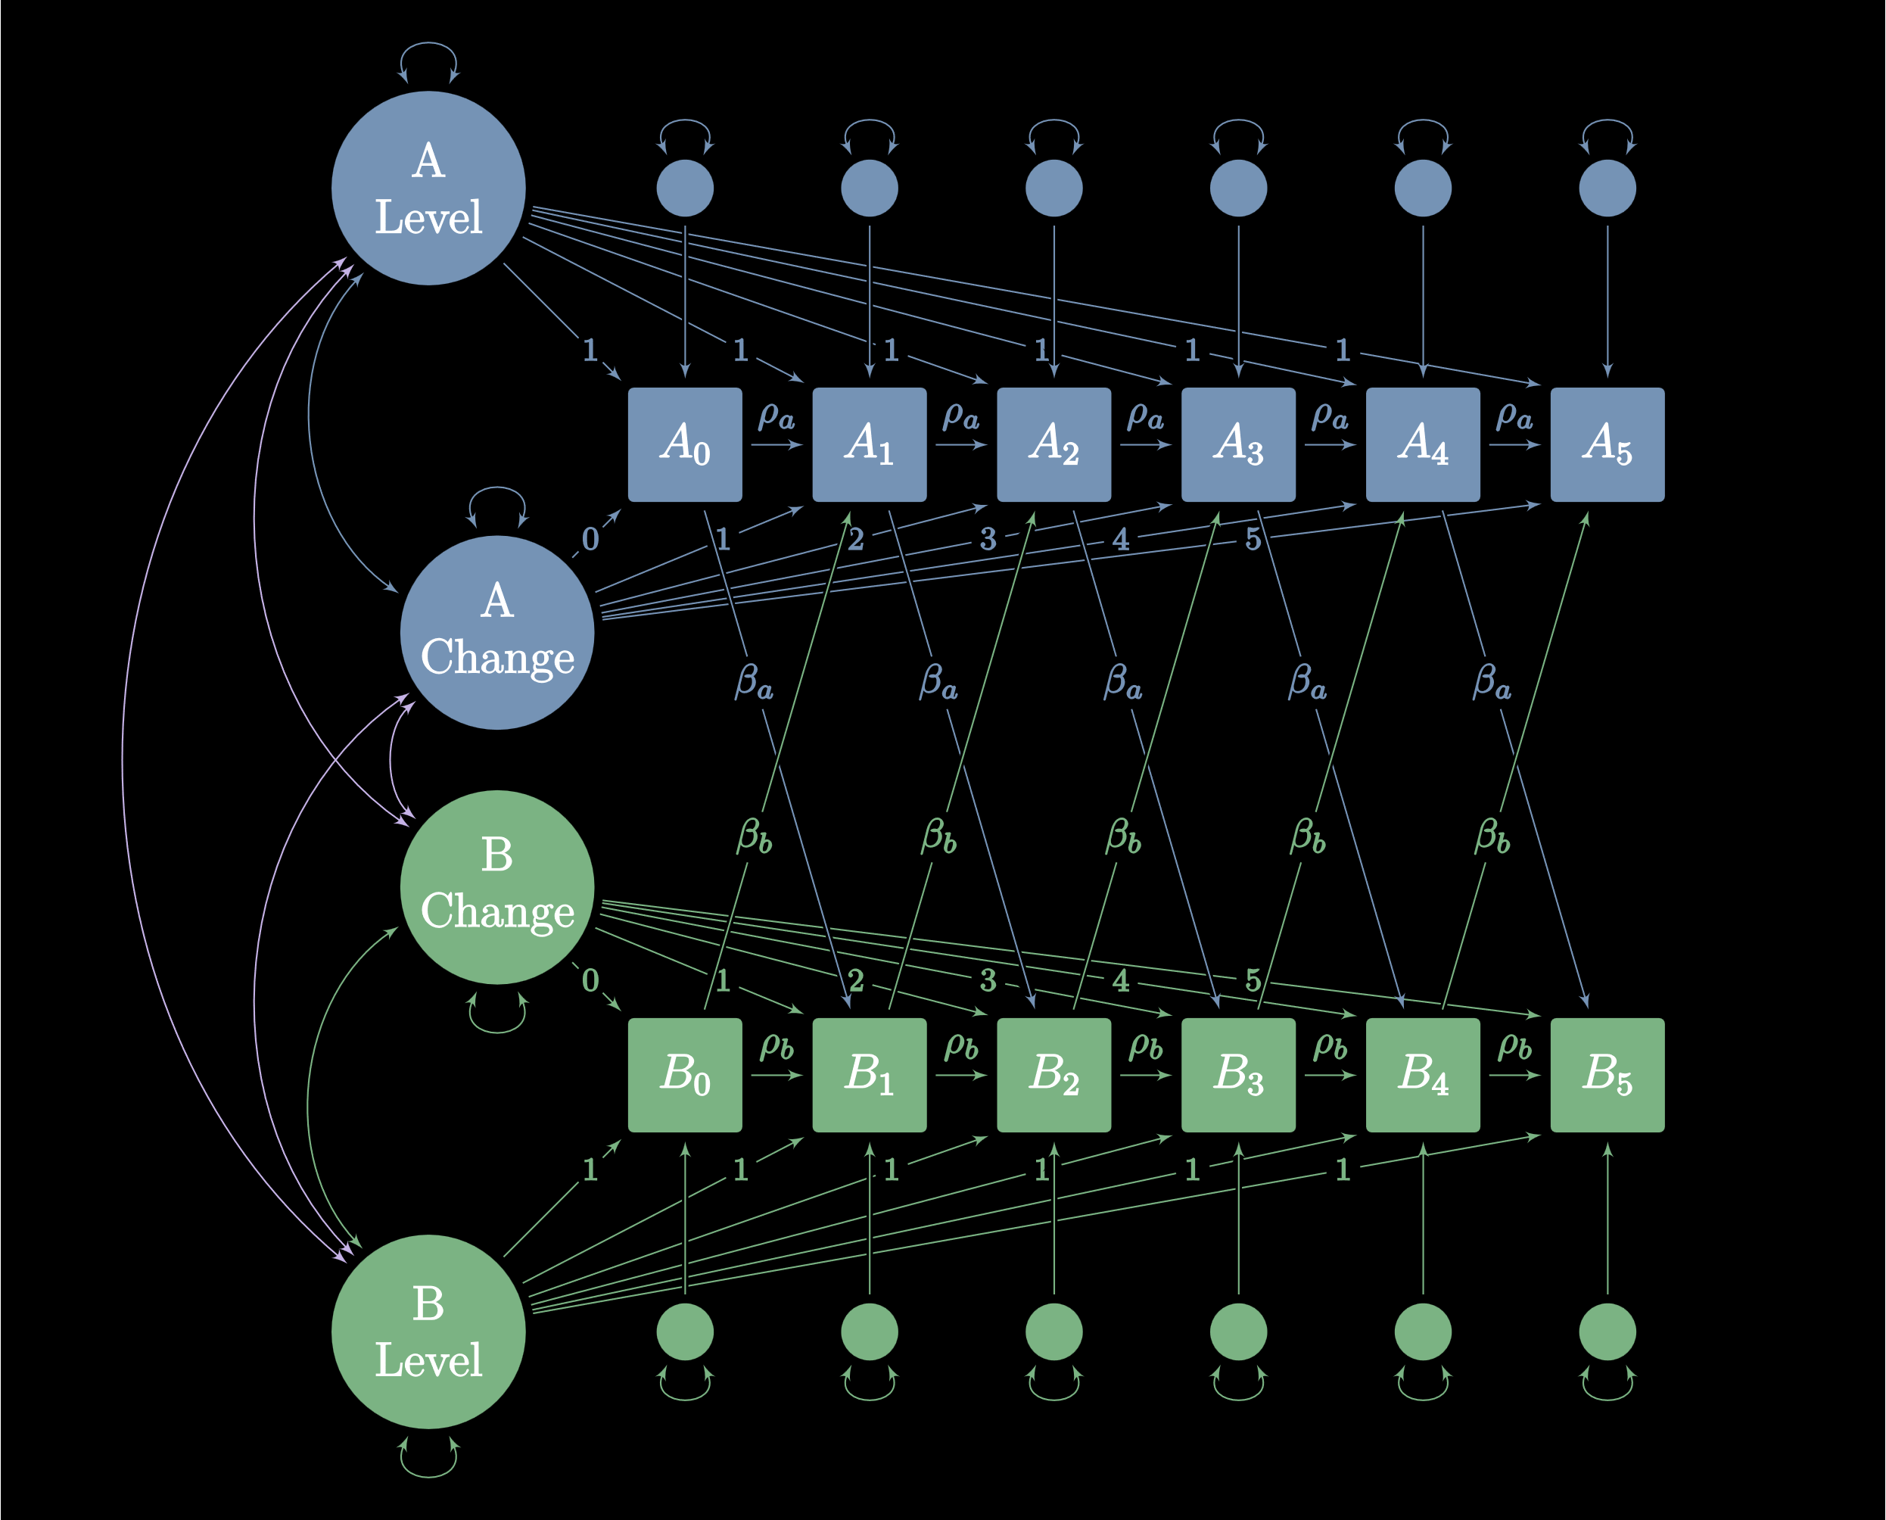
Autoregressive Cross-Lagged Latent Trajectory

Slide 17
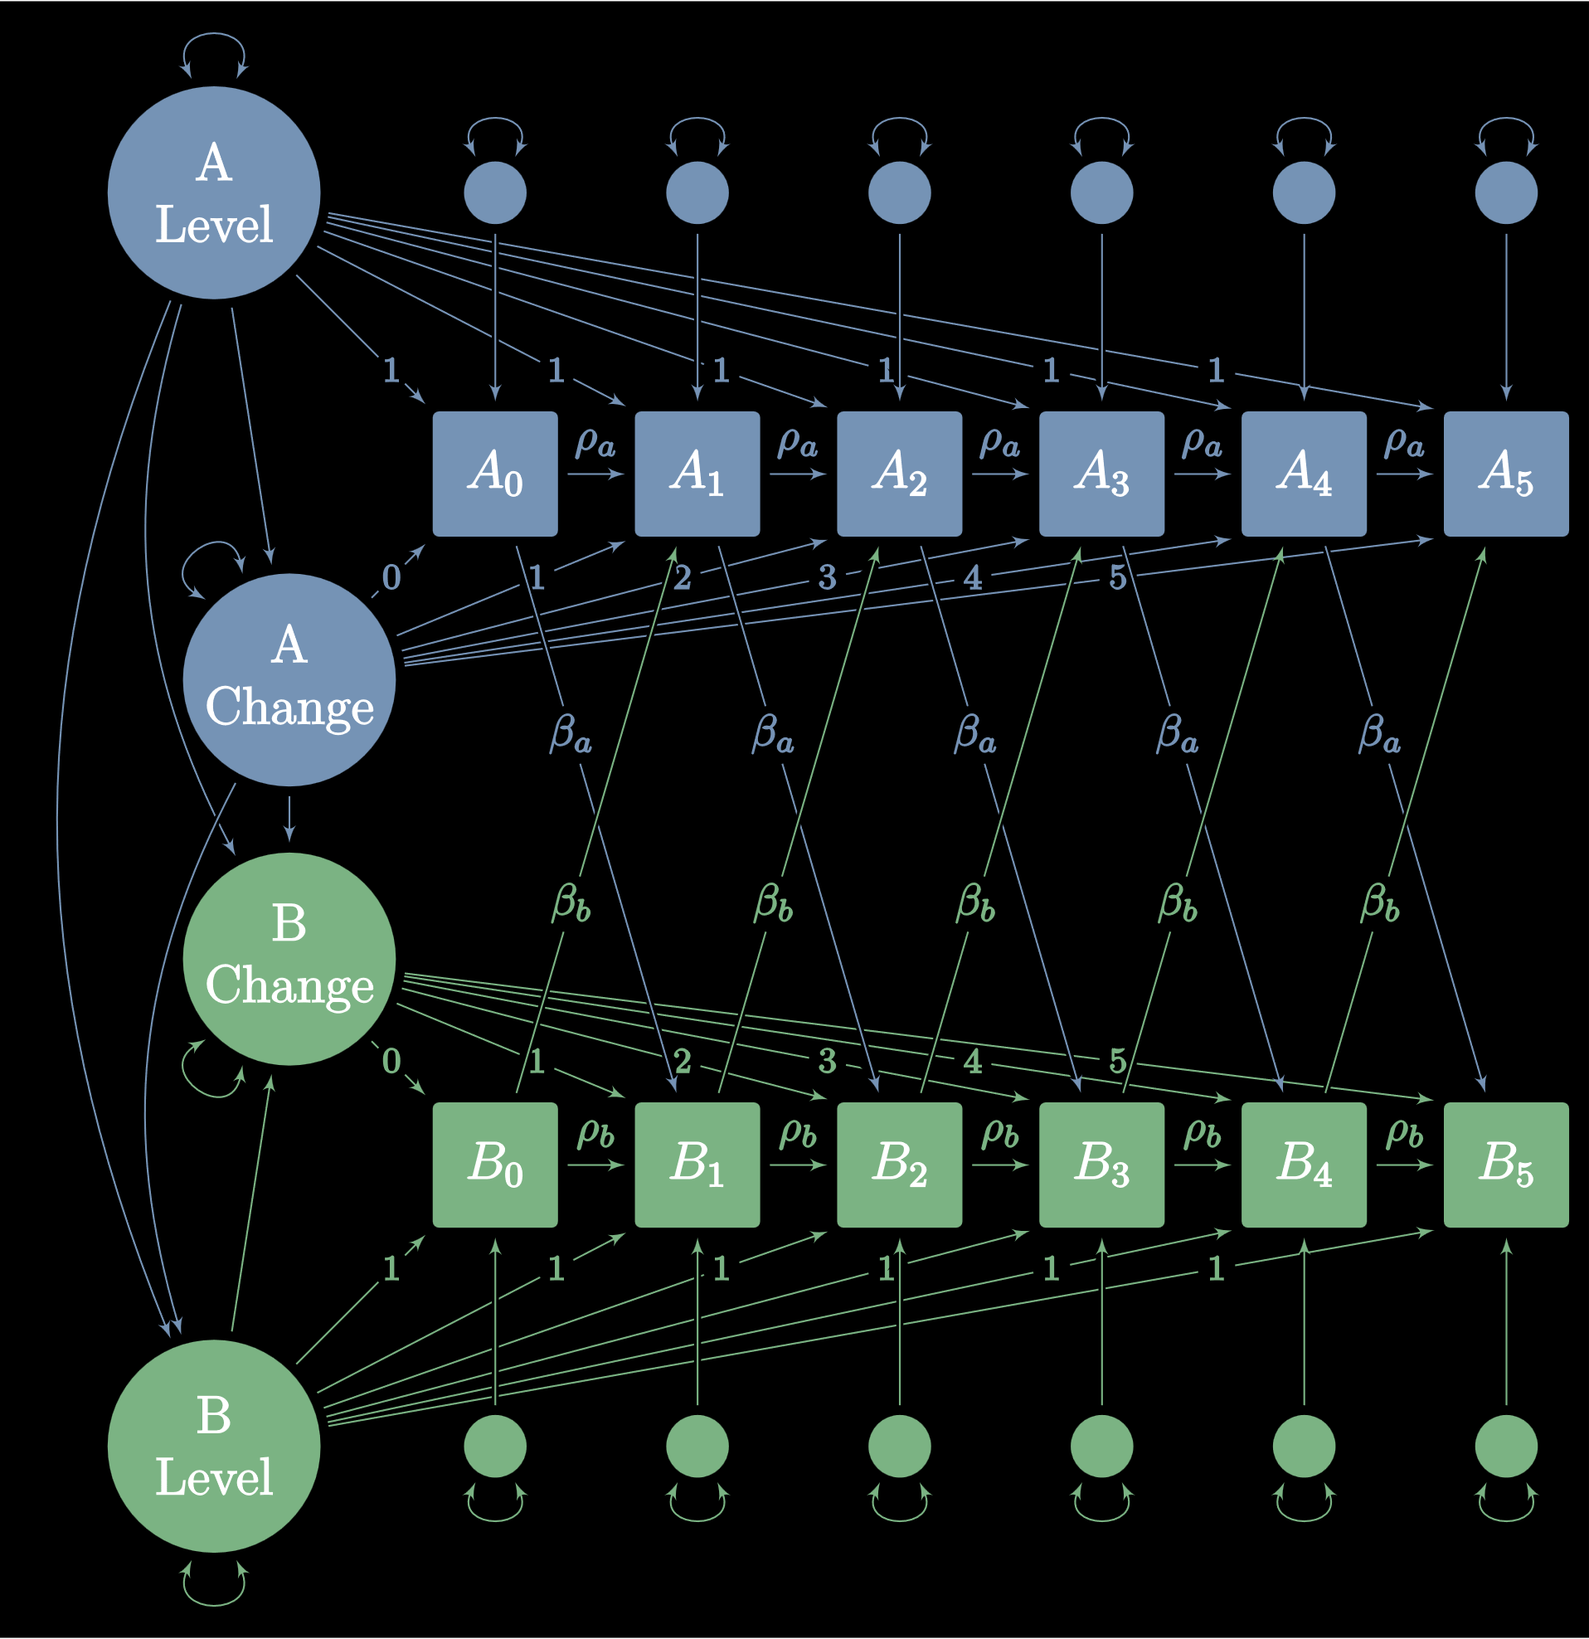
Autoregressive Cross-Lagged Latent Trajectory

Slide 18
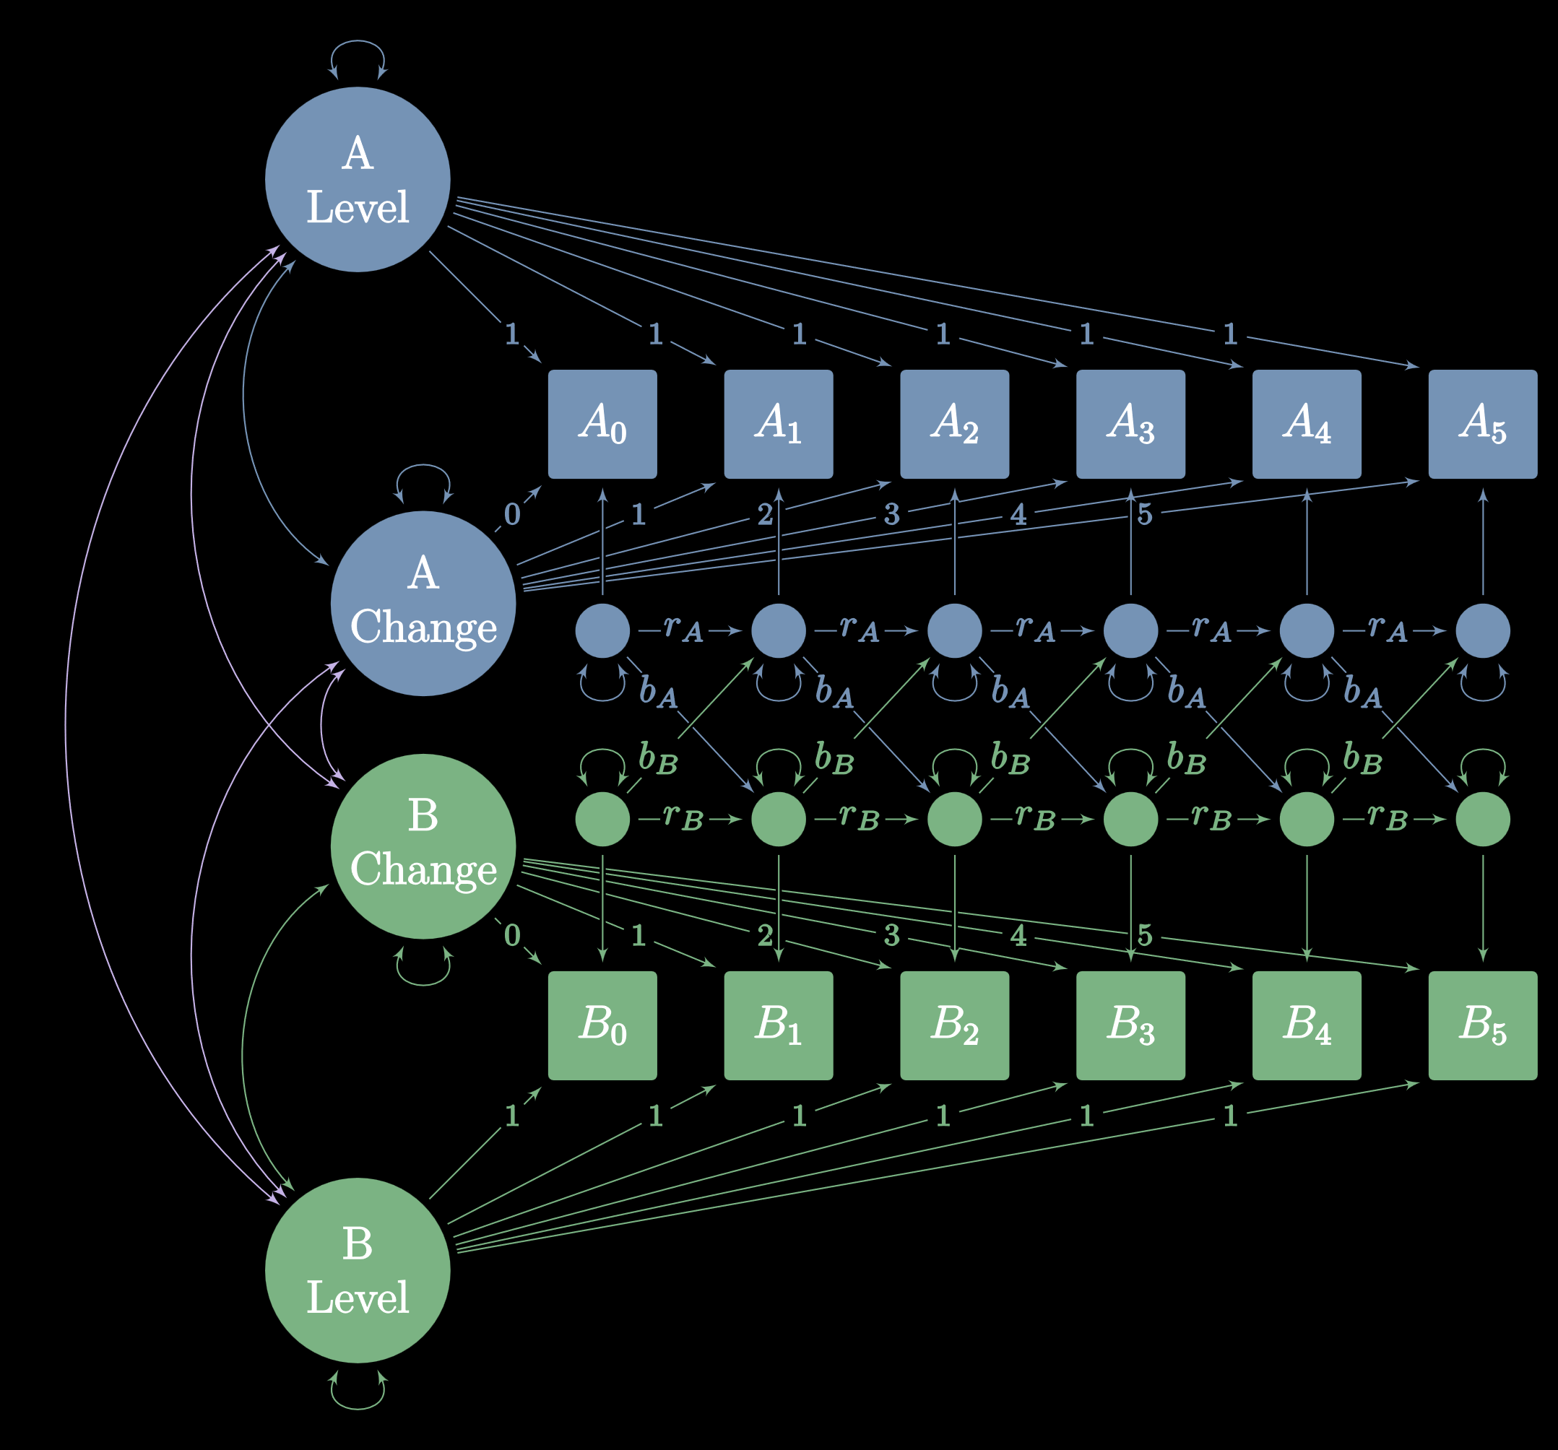
Autoregressive Cross-Lagged Latent Trajectory With Structured Residuals Separating Between and Within-Person Change

Slide 19
Structured Residuals Latent variables that behave like residuals
Unlike regular “unstructured” residuals, structured residuals can predict other variables and be predicted by other variables.
Trick lavaan into thinking that a latent variable is a structured residual:
Observed variable x loads onto structured residual e_x with factor loading of 1:
e_x =~ 1 * x
Set e_x’s intercept to 0:
e_x ~ 0 * 1
Set e_x’s variance to a named parameter:
e_x ~~ tau_ex * e_x
Set variance of x’s “unstructured” residual to 0:
x ~~ 0 * x

Slide 20
Automation with paste0
Concatenate text
friend <- "Dave"
when <- "today"
paste0("Hello, ", friend, "! Nice to see you ", when, ".")
#> Hello, Dave! Nice to see you today.
friend <- c("Andy", "Wendy")
when <- c("yesterday", "last week")
paste0("Hello, ", friend, "! Nice to see you ", when, ".")
#> Hello, Andy! Nice to see you yesterday.
#> Hello, Wendy! Nice to see you last week.

Slide 21
Automation with paste0
\n is a new line:
paste0("x", 1:k, " ~~ 0 * x", 1:k,
collapse = "\n")
x1 ~~ 0 * x1
x2 ~~ 0 * x2
x3 ~~ 0 * x3
x4 ~~ 0 * x4
x5 ~~ 0 * x5
x6 ~~ 0 * x6

Slide 22
Automation with paste0
-
Make a latent random slope:
paste0("slope =~", paste0(1:k - 1, " * x", 1:k, collapse = " + "))
#> slope =~ 0 * x1 + 1 * x2 + 2 * x3 + 3 * x4 + 4 * x5 + 5 * x6

Slide 23
Automation with glue
Anything in {} is R code:
library(glue)
friend <- "Dave"
when <- "today"
glue("Hello, {friend}! Nice to see you {when}.")
#> Hello, Dave! Nice to see you today.
friend <- c("Andy", "Wendy")
when <- c("yesterday", "last week")
glue("Hello, {friend}! Nice to see you {when}.")
#> Hello, Andy! Nice to see you yesterday.
#> Hello, Wendy! Nice to see you last week.

Slide 24
Automation with glue
Make many variances at once!
k <- 6
glue("x{1:k} ~~ 0 * x{1:k}") %>%
glue_collapse(sep = "\n")
x1 ~~ 0 * x1
x2 ~~ 0 * x2
x3 ~~ 0 * x3
x4 ~~ 0 * x4
x5 ~~ 0 * x5
x6 ~~ 0 * x6

Slide 25
Automation with glue
Make a latent random slope:
glue("slope =~ ",
glue("{1:k - 1} * x{1:k}") %>%
glue_collapse(sep = " + ")
)
#> slope =~ 0 * x1 + 1 * x2 + 2 * x3 + 3 * x4 + 4 * x5 + 5 * x6

Slide 26
Automation with glue
Data and glue
library(tidyverse)
library(glue)
crossing(person = c("Dave", "Andy", "Wendy"),
task = c("task 1", "task 2")) %>%
glue_data("{person} is assigned to {task}.")
#> Andy is assigned to task 1.
#> Andy is assigned to task 2.
#> Dave is assigned to task 1.
#> Dave is assigned to task 2.
#> Wendy is assigned to task 1.
#> Wendy is assigned to task 2

